Slide 1



42 Prague
14/11/2025
EDUZMENA
HACKATHON
Powered by DigiEduHack
VATSAL BALI
ADRIAN CARBALLO
OLZHAS TURETAYEV
SEYIT PELIT

Slide 2


1 | PRESENTATION OF THE TEAM
2 | PROBLEM
3 | APPROACH
4 | SOLUTION
5 | FUTURE UPGRADES
INDEX

Slide 3


PROBLEM AND REQUIREMNETS
Clarify the project's main overall objectives and goals.
REQUIREMENT# 1
REQUIREMENT# 2
REQUIREMENT# 3
CLEAN ESTRUCTURE AND USER FRIENDLY
SACALABILITY AND PERFORMANCE
FEASIBLITY

Slide 4
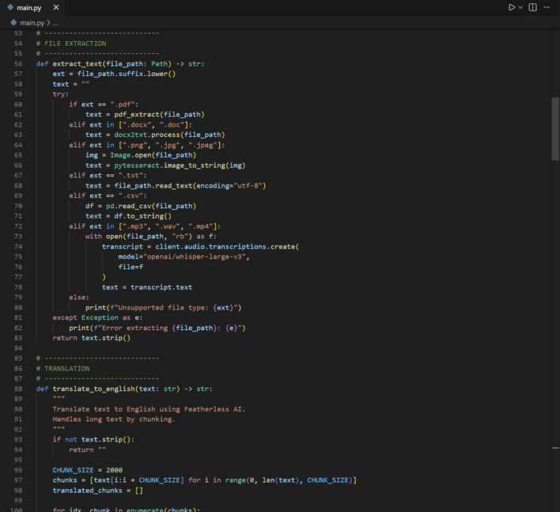

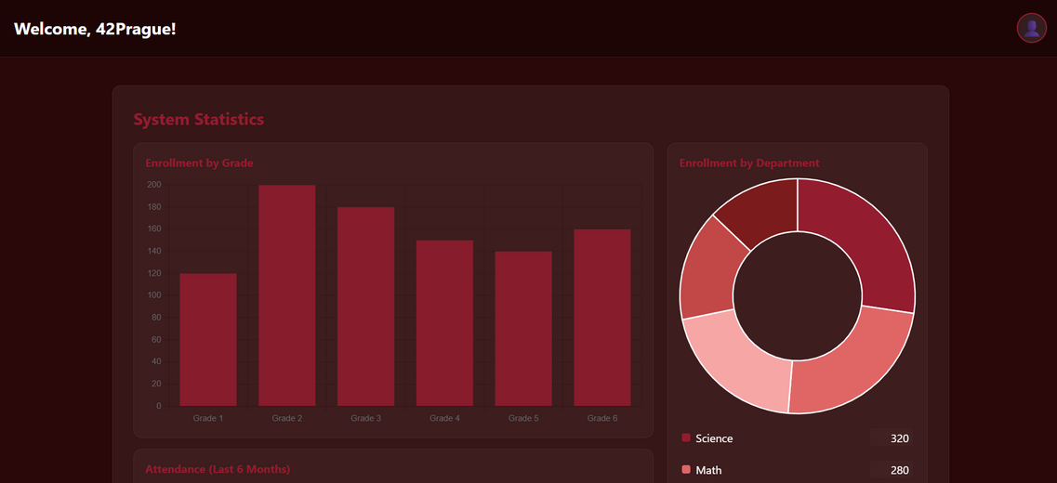
APPROACH
CREATION OF A DATA ESTRUCTURE, INTEGRATION OF AI TOOLS, DELIVERY OF A WEBSITE

Slide 5
SOLUTION
DATA CATEGORAZATION AND FILTERING
INFORMATION STORAGE USING AI TOOLS AND ACCESS TO IT FOR FUTURE PURPOSES
GRAPHS, CHARTS, AND TRENDS BASED ON THE INFORMATION SAVED

Slide 6


FUTURE UPGRADES
1st Step
2nd Step
3rd Step
4th Step
IMPROVE THE PERFOMANCE
SCALE TO BIGGER FILES
ACCEPT MORE FILE FORMATS
DELIVERY ON EVERY REGION

Slide 7
Thank you!
Any questions?

